Slide 1

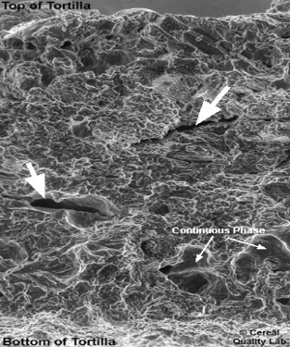
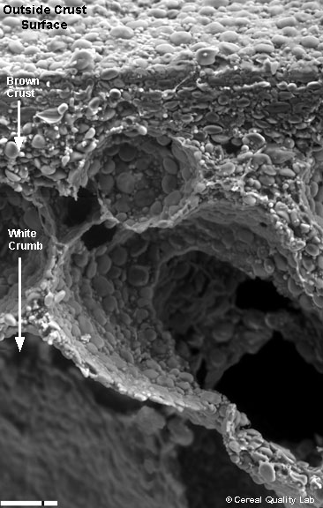
Food/Biological Materials Physical
and Chemical Properties
Properties of Biological Materials are affected by chemical composition and microstructure
Composition
Water
Carbohydrates
Proteins
Fat
Minor Components
Minerals
Vitamins
Other Chemical Compounds
Solids Non-fat (SNF)
Solids
Microstructure
Foods and biomaterials have a microstructure imparted either by nature or through processing. All relevant properties are structure sensitive (e.g. rheological properties, thermal properties)
Bread
Corn Tortilla

Slide 2
Physical Properties
Physics: The study of the interaction of matter and energy
Property: An attribute or characteristic of an object or material
Physical Property: An attribute of the material that gives a particular measure of the material behavior as matter or its behavior with respect to energy
THERMAL PROPERTIES (Physical-Chemistry)
MECHANICAL PROPERTIES (Rheology)
SORPTION AND DIFFUSION PROPERTIES
ELECTROMAGNETIC PROPERTIES
Intrinsic
Properties
Physical
Properties
Non-Intrinsic
Properties

Slide 3
INTRINSIC PROPERTIES
They are independent of how much material of “the material” is present.
Property of the material itself, such as:
True Density, (kg/m³)
Viscosity, (Pa.s)
Specific Heat Capacity, c (J/kgK)
They depend mainly on the chemical composition of the material
They may also depend on the material structure (e.g. rheological properties)
Microstructure and Properties Paper

Slide 4
NON-INTRINSIC PROPERTIES
(a) It depends on, or has to do with, the sizes and/or shapes of pieces, or interactions between pieces of the material
(b) A property that depends either wholly or in part on the system in which the material finds itself (e.g. heat transfer coefficient)
Powder Angle of Response

Slide 5
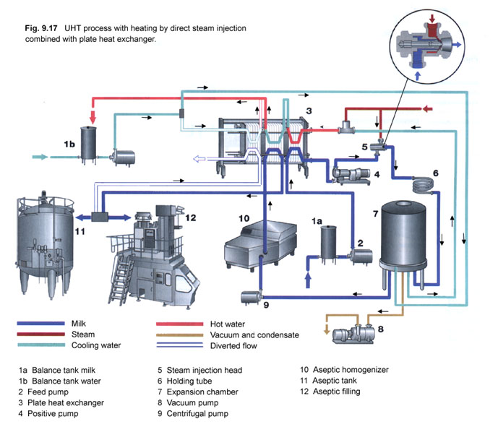
NON-INTRINSIC PROPERTY
Heat Transfer Coefficient

Slide 6
How important is to known the properties of biomaterials?
Material Properties
Raw Materials
Material Properties
Bio Processing
Momentum Transfer
Heat Transfer
Mass Transfer
Final Products
Material Properties

Slide 7
USES OF PHYSICAL PROPERTIES
Engineering Design, Installation, Optimization and Operation of Bio Processes and Bio Processing Equipment.
Quality Control and Automatic Process Control
Instrumental Measurement of Organoleptic (Sensory) Properties
Fundamental and Applied Research and Product Development.
Selection of Packaging Materials, Design of Packages, Packaging Machines and Packaging Operations.

Slide 8
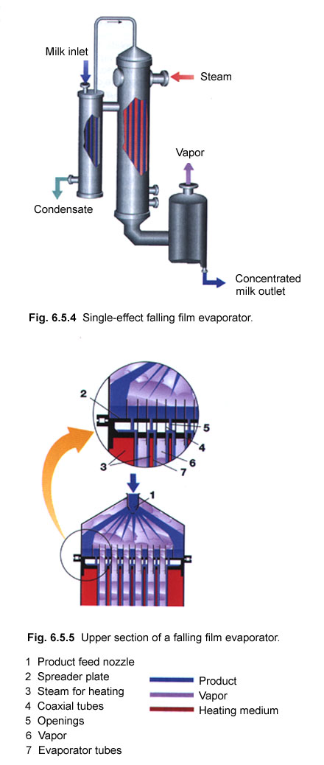
1. Engineering Design, Installation, Optimization and Operation of Bio-processes and Bio-processing plant and equipment
Evaporation

Slide 9
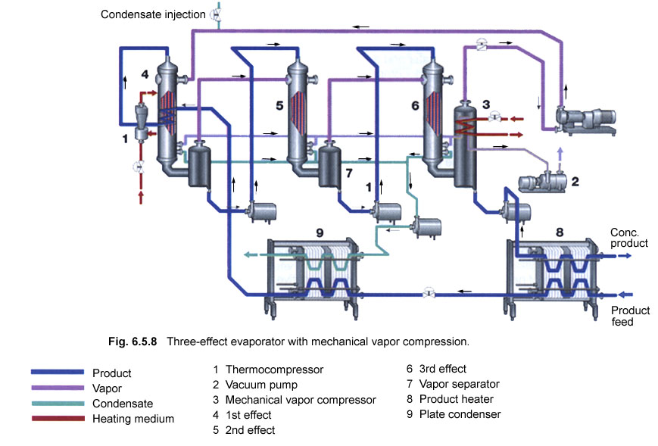
Three Effect Evaporator

Slide 10

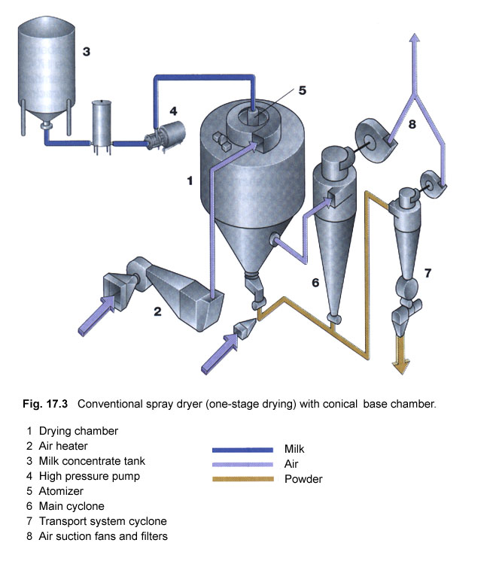
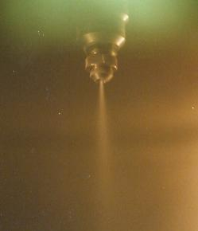
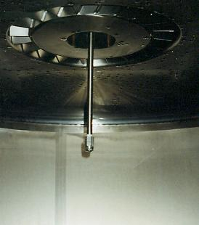
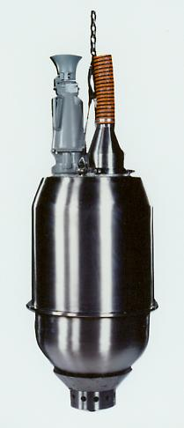
Milk Powder Production

Slide 11
2. Quality management and automatic control
Quality Assurance (QA)
Are we doing the right things?
QA sets standards for raw materials, intermediate materials and finished products. Set processing conditions
Quality Management
Quality Control (QC)
Are we doing things right? Are we successfully meeting the specifications and standards and keeping to the processing conditions laid down by QA ?
Examples
Freezing point of milk to check adulteration
Infra-red (IR) spectroscopy to determine chemical composition of materials
Refractive index to measure concentration (e.g. production of milk powder, jams and condensates)

Slide 12
2. Quality management and automatic control
Automatic Process Control
Set Point
Controller
Constant flow rate
In line flowmeter
Concentrated Sugar Solution
Set Point
Controller
Diluted Sugar
Solution of constant
composition
Water
In line Refractometer

Slide 13
3. Instrumental Measurement of Organoleptic Properties
Sensory
Test (trained
Panel)
Instrumental
Measurements
Texture
Flavor
Smell
Aroma
Color
Gel Strength
Viscosity
Texture
Flavor (Use of GC)
Color
Relationship ?
GC: Gas Chromatography

Slide 14
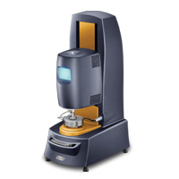
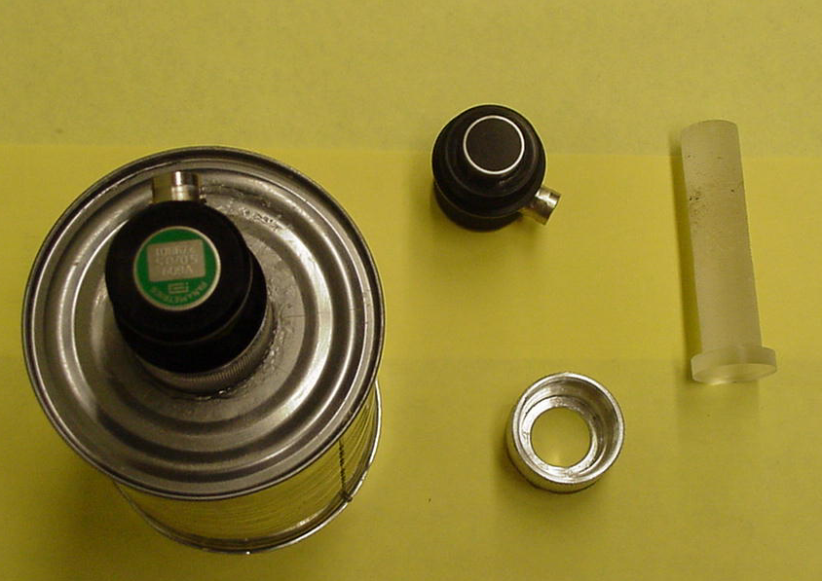
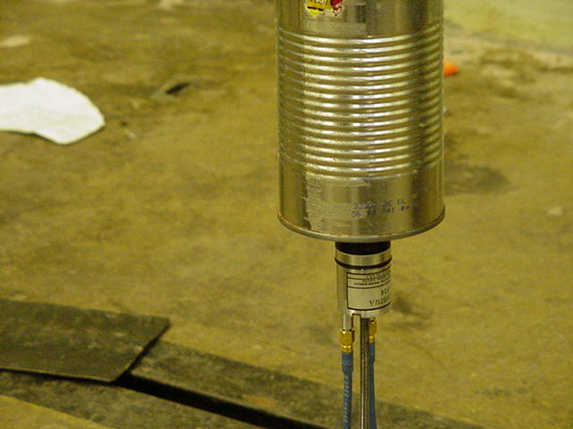
4. Fundamental and Applied Research and Product Development
Gelation of Whey Proteins (e.g. using heat)
Rheological Property
Rigidity Modulus
Gelation Point
Time
5. Selection of packaging materials, design of packages, packaging machines and packaging operations
Water Mobility (mass transfer)
Vapor, Gases Mobility (mass transfer)
Light, Heat (heat transfer)
Mechanical Properties (rheology, fluidmechanics and mechanics)

Slide 15
Mechanical Properties: Characterize a material as matter, or the material behavior due to the action of forces
1. Morphometric Properties
Size and shape
Consumer acceptability of some products (fruits)
Design of sorting and cleaning equipment
Operations depending on aero- and hydrodynamic properties
Heating and cooling of foods packaging
Surface Area
Processes involving mass transfer through surfaces, e.g. extraction of coffee beans, fruit respiration, smoking of ham, water into or out of the package
Determining usable material, e.g. peeling of small products produces more waste than peeling of large products (e.g. potatoes)

Slide 16
2. Particle Size Distribution
Fraction or Percentage
Particle Diameter
Designing size separation equipment
Operating extraction processes (e.g. extraction of soluble material of ground coffee or production of instant coffee - clogging extraction columns
Rheology of solid suspensions, mouthfeel, texture
Product specifications, e.g. powder milk, particle size affects hydration of the powders

Slide 17
3. Aerodynamic and Hydrodynamic Properties
Pneumatic Conveying
Hydraulic transport
Terminal velocity of particles in fluids
Wheat contaminated
by weed seeds
weed seeds
Wheat
grains
Air Flow

Slide 18

COFFEE FARMS IN BRAZIL

Slide 19
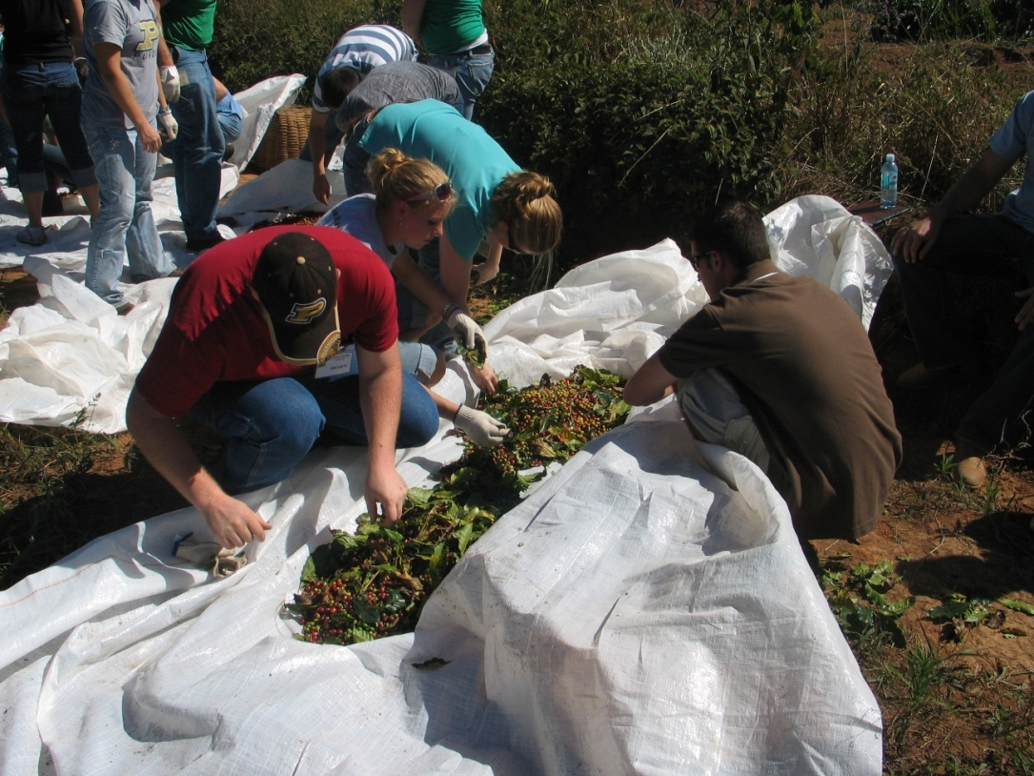
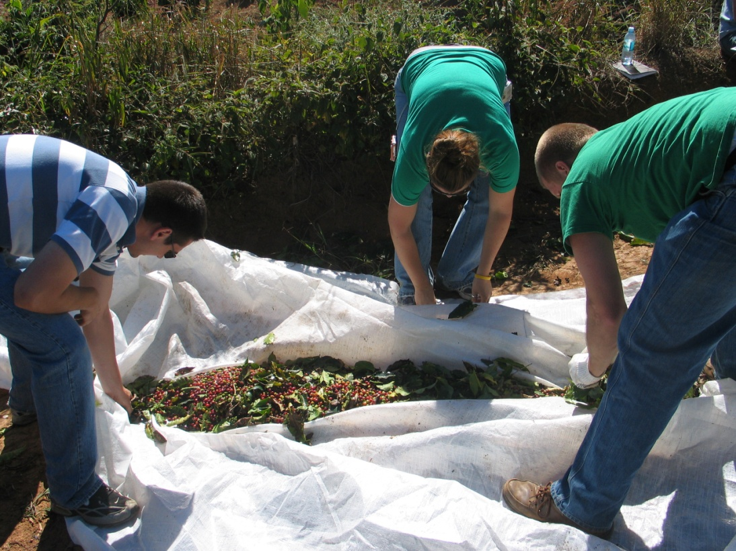
Harvesting Coffee

Slide 20
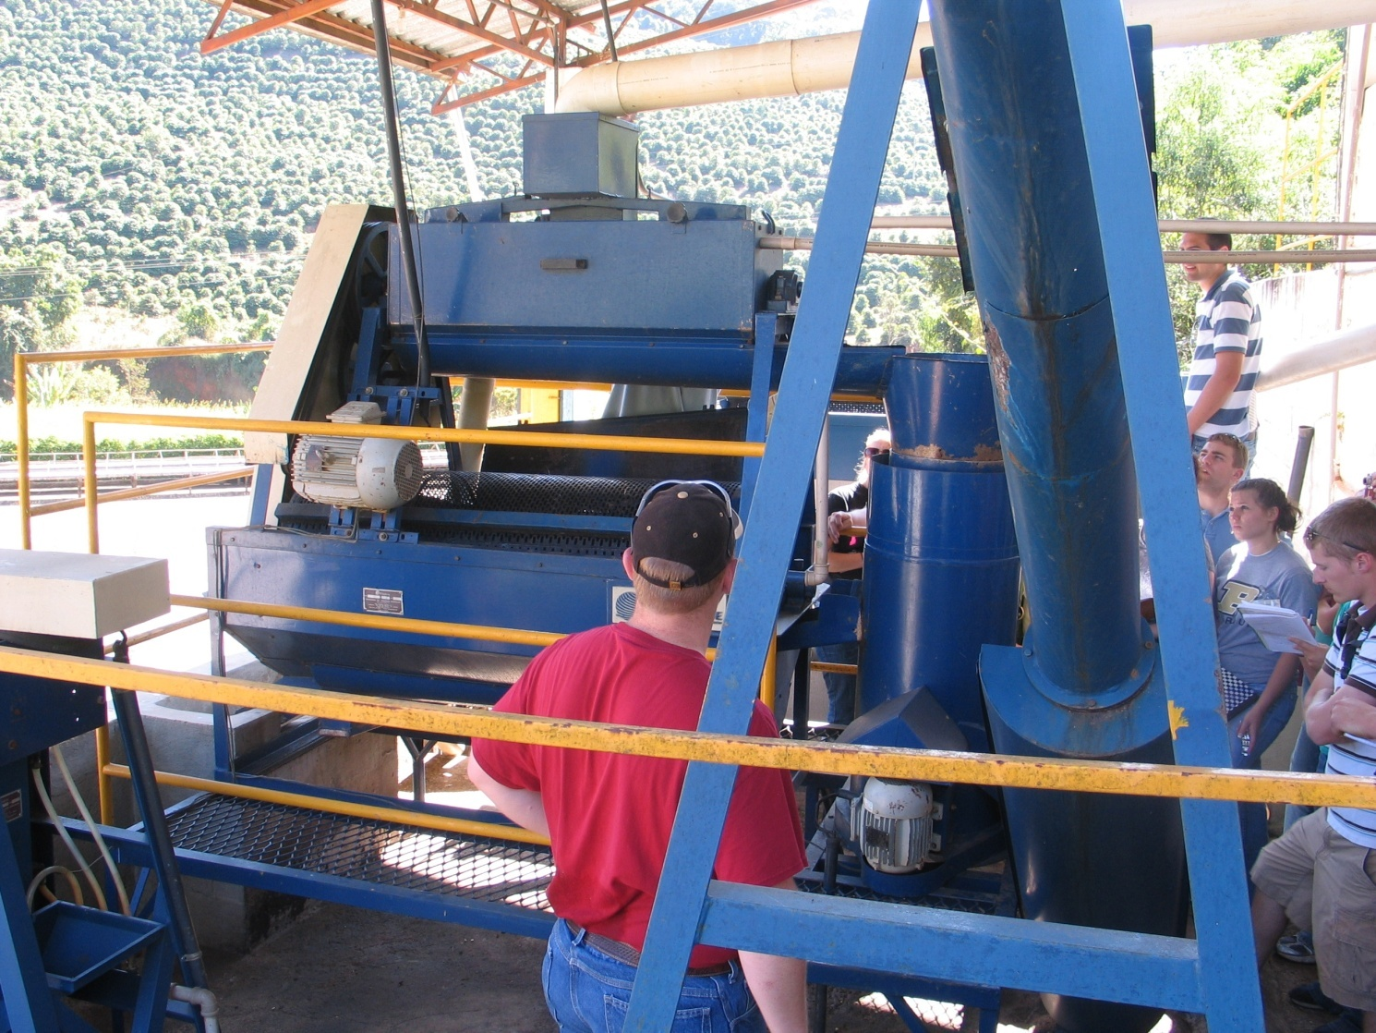
Classifying Coffee

Slide 21
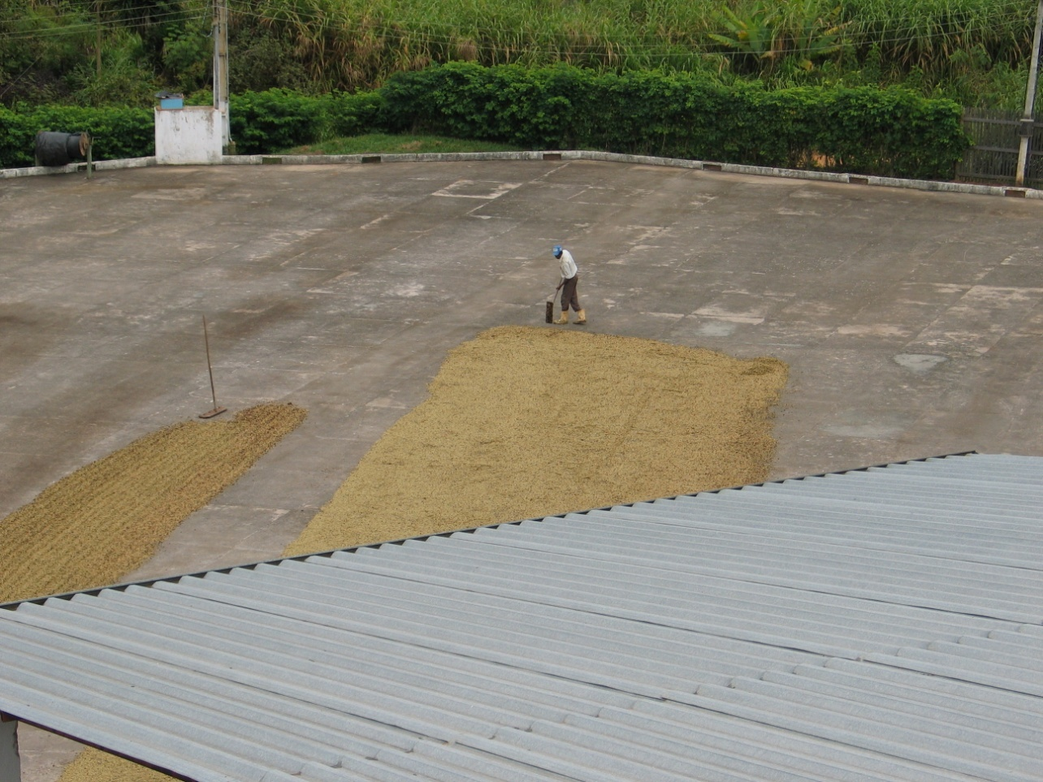
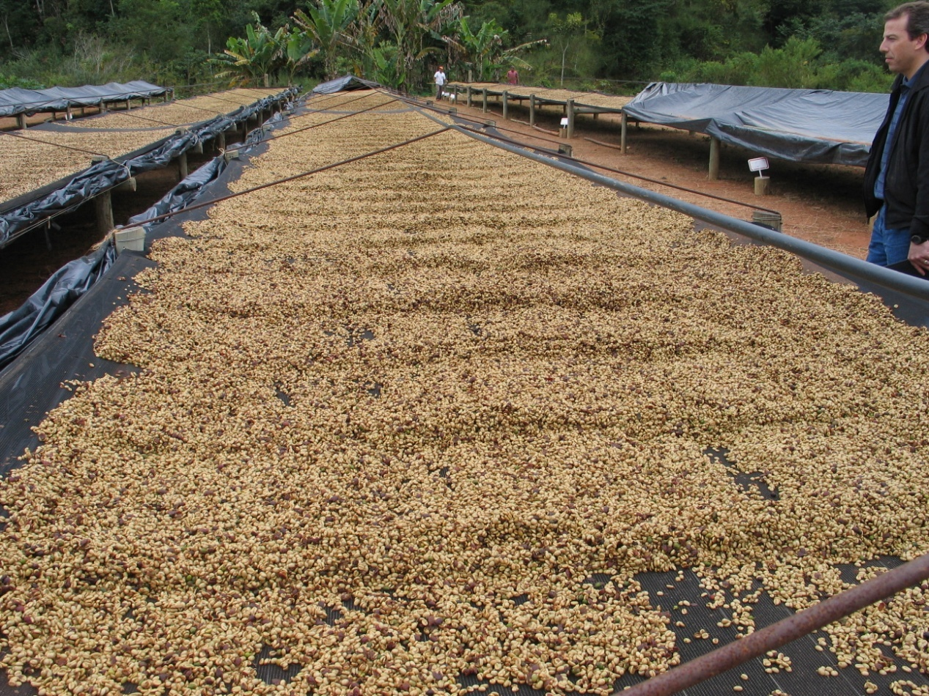

Slide 22
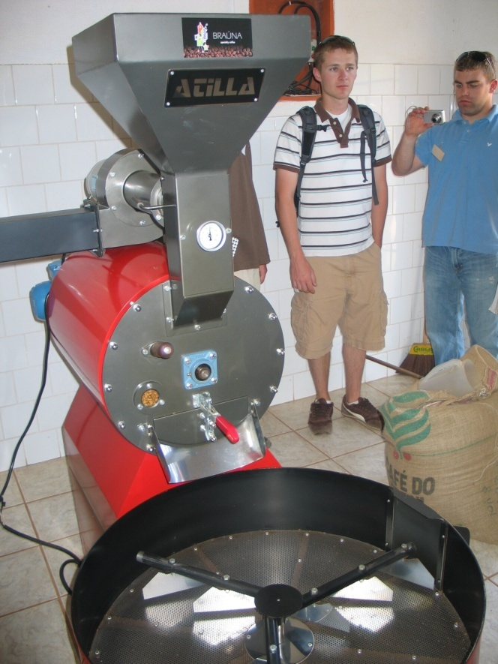
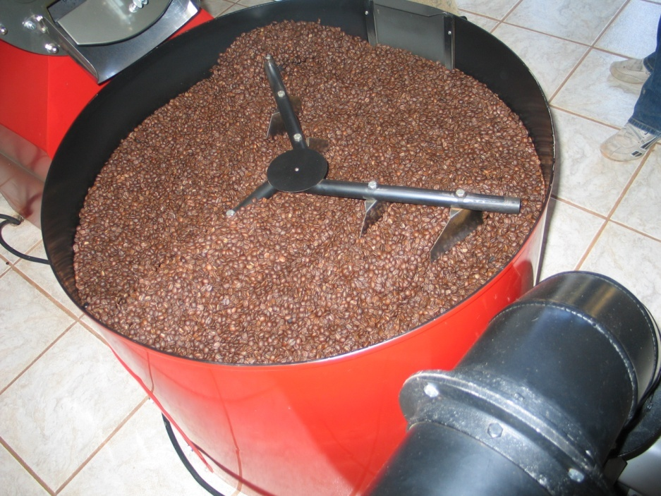
Roasting Coffee

Slide 23
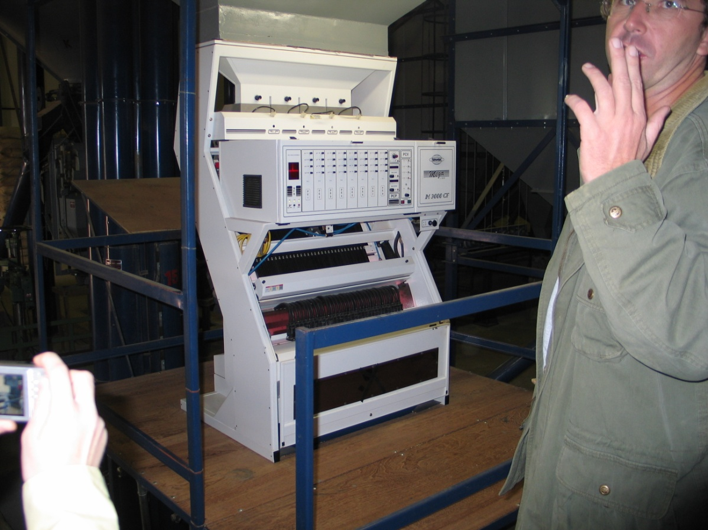
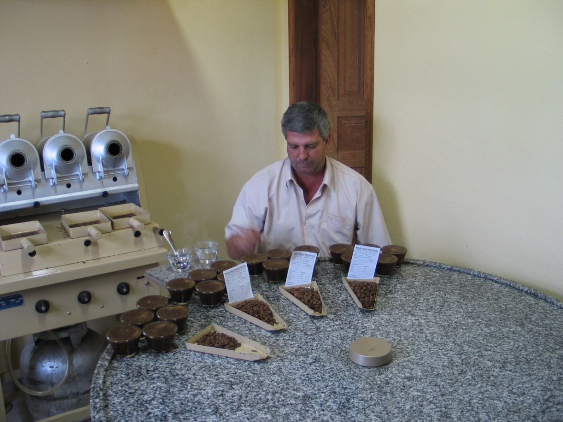
Bean separation by color
Coffee Quality Control (Organoleptic Prop.)

Slide 24
4. Surface Properties
Homogenization
Emulsion
Interfacial Tension
Measure the resistance of the interface to be enlarged
Emulsions
Salad dressings
Cream
Milk
Pharmaceutical products
Interface
When one of the phase is a gas and the other a liquid
The property is called surface tension
Material Surface Tension (mN/m)
Water 72.7
Ethyl Alcohol 22.7
Milk 50

Slide 25
5. Acoustic Properties
Sound Wave
Sound Velocity and Sound Attenuation
Monitor the freezing of meat
Monitor the freezing of orange juice
Composition of materials
Viscosity of liquids inside cans
Sound patterns recorded by chewing food products
Sample
6. Frictional Properties of objects
Force to initiate movement
F_{s} or F_{K}
W (weight)
Force to maintain movement

Slide 26
7. Frictional Properties of particulates and powders
Powder Angle of Response
W
Jenicke Cell
F
Powder
W
W
F
Powder
Angle of Internal
Friction

Slide 27
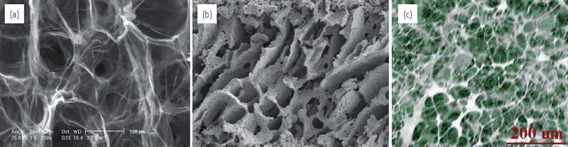
PHYSICAL PROPERTIES - Density and Porosity
Why are they important?
Tissue Engineering: The developing field of tissue engineering (TE) aims to regenerate damaged tissues by combining cells from the body with highly porous scaffold biomaterials, which act as templates for tissue regeneration, to guide the growth of new tissue (O’Brien, 2011, Materialstoday)
Collagen (CG)
Scaffold
Hydroxypatite (HA)
Scaffold
Composite collagen-HA
Scaffold
Do these results make sense?

Slide 28
PHYSICAL PROPERTIES Density and Porosity
Food/Biological Materials
Solids
Water
Air
Solids No Fat (SNF)
Fat
Other minor components
It does not account
for the weight of air
Mass of the material
It takes into account
the volume of air
Volume of the material
Density of material

Slide 29
Specific Volume
(per unit of mass of dry solid)
Moisture Content
(on a dry basis, kg water/kg dry solid)
Material Shrinkage

Slide 30
PHYSICAL PROPERTIES
CHANGES IN MATERIAL MICROSTRUCTURE DURING PROCESSING
Volume of Water which:
disappears (Shrinkage)
Water
remains as “water”
Water
becomes and
remains as “air”
Air
Air
Solids
Solids
Initial Moisture Content X_{i}
Moisture Content X
What are the differences in mechanical properties of the material that shrinks and the material that does not shrink, i.e. it does not deform?

Slide 31
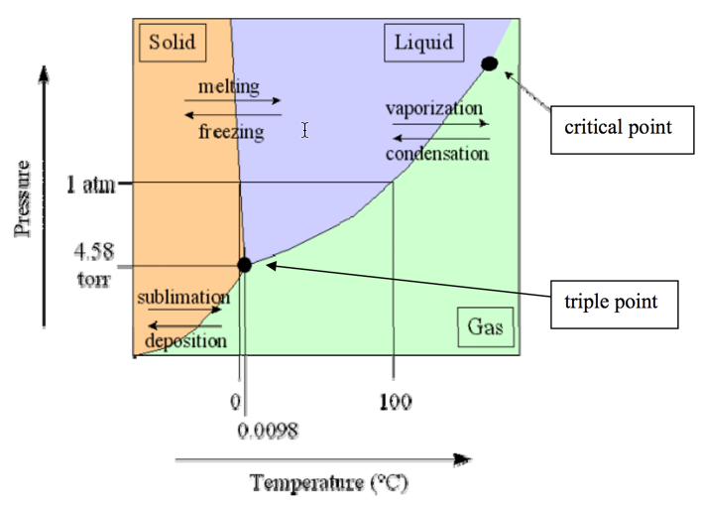


Freeze Dried Fruits
They lost water but not size/shape
Freeze Drying = Lyophilization
Normal dried fruits, they lost water and size/shape

Slide 32
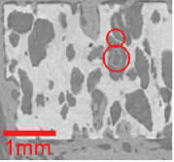
POROSITY AND DENSITY
Scaffolds

Slide 33
POROSITY AND DENSITY
Mass Transfer
properties

Slide 34
POROSITY AND DENSITY

Slide 35
DENSITY AND POROSITY
True Density
Substance Density
Particle Density
Apparent Density
Bulk Density
Apparent Porosity
Open Pore Porosity
Closed Pore Porosity
Bulk Porosity
Total Porosity

Slide 36
PHYSICAL PROPERTIES
Density
Porosity
V_{pores}
V_{total}
V_{solid}
The mass only includes the mass of solid, the weight of gas (air) in the pores is very small
The volume of material includes the volume of solid and pores
Porous materials result in lower densities

Slide 37
True Density
(For a non-porous material)
It is calculated from the densities of the material pure components
For a substance comprising three components

Slide 38
Substance Density
It is the density of a non-porous substance as measured
The substance density of a porous material must be measured after the material has been broken in pieces without pores
If there is interaction between components
is the adjustment to calculate
No interaction
It must be calculated experimentally, it can
positive or negative

Slide 39
Particle Density
Closed Pore
Open Pore
Material
Substance
It includes closed pores

Slide 40
Apparent Density
Includes open and closed pores
Open Pore
Closed Pore
Material
Substance
(solid)
For non-porous materials

Slide 41
Bulk Density,
Includes all the particles and space between them
Bulk Volume
(Container)
Particle
Design of packaging of particulates foods
Design of ventilation systems for removing heat produced by the material respiration (e.g. silo, apples in a carton)
Important in heat and mass transfer calculations

Slide 42
Different forms of porosity
Apparent Porosity
Open pore porosity
Closed pore porosity

Slide 43
Bulk Porosity
For a porous material
For a non-porous material
Total Porosity
Important in the calculation of capacities and predicting thermal conductivity and thermal diffusivity

Slide 44
Specific Gravity
Specific volume

Slide 45
Examples
Given that the particle density of the oat grain is 1546 kg/m³, and the bulk porosity of oat grains is 0.4, what volume silo would be required to store 3000 tons of oats?
2. Milk powder is to be packed in nitrogen gas in hermetically sealed bags (to protect it from oxidative deterioration), each bag contains 25 kg of powder. Using the data given below
Calculate:
(a) The bag volume required
(b) The volume of nitrogen gas required per bag
Data
Substance Density = 1100 kg/m³
Closed Pore Porosity = 0.15
Total Porosity = 0.43

